Slide 1

FAIKR mod.3
ARTIFICIAL INTELLIGENCE
BAYESIAN HEART FAILURE PREDICTION
Presented by: Mauro Dore, Leonardo Monti

Slide 2
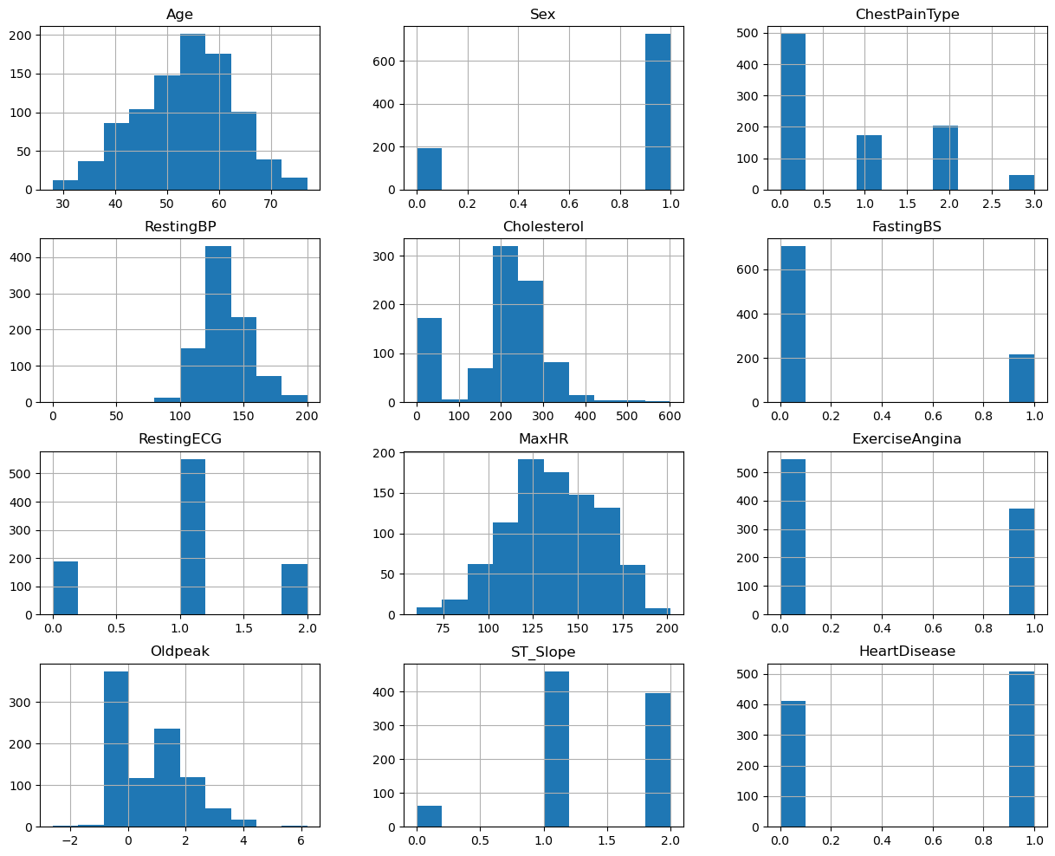
Introduction
The aim of this project is to develop and evaluate Bayesian Network (BN) models and compare the effectiveness of four distinct BN modeling strategies at assessing the risk of suffering from Cardiovascular Disease and investigating the conditions that lead to it.
The dataset comprises 918 unique patient records, including 11 relevant features, such as demographic information, clinical measurements and electrocardiographic findings.
Distribution of the data

Slide 3

PREPROCESSING
Encoding
Categorical features were converted into numerical representations.
Numerical data were binned into categories
Binning
Values of 0 (e.g. Cholesterol) were identified as "nulls in disguise" and were imputed with the median.
Imputation
Duplicate rows were checked and any missing value.
Check
Exclude flat sensors

Slide 4
THE NETS
HAND CRAFTED
SEARCH BASED
Custom model
Bayesian Network with all the features.
Casual links between the features have been designed by correlation and the authors’ knowledge.
Tree model
HillClimb model
Constraint-Based
Learned automatically from the dataset unsing a scoring function.

Slide 5

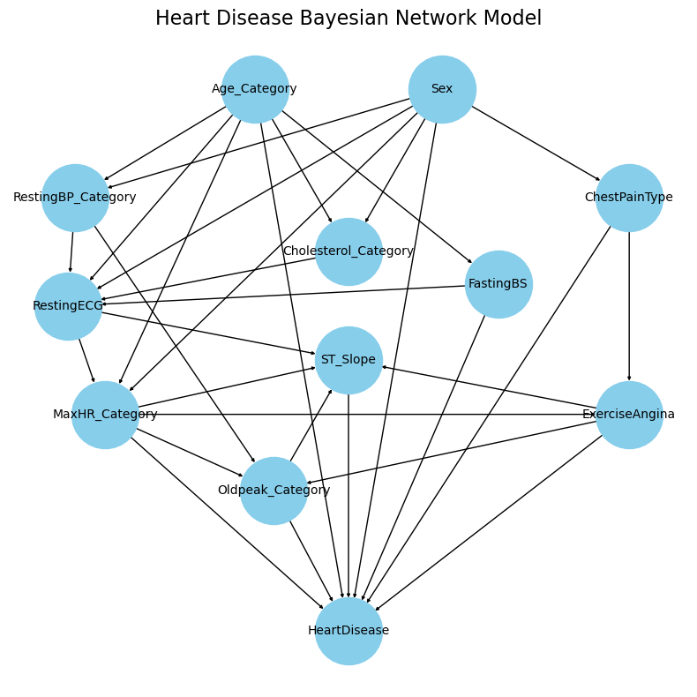
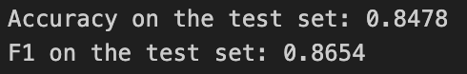
CUSTOM
MODEL
Bayesian Network with all the features provided by the dataset.
The causal links between the features have been designed by looking at the correlation plot characterizing our data and the authors’ cardiology knowledge .
Metrics

Slide 6
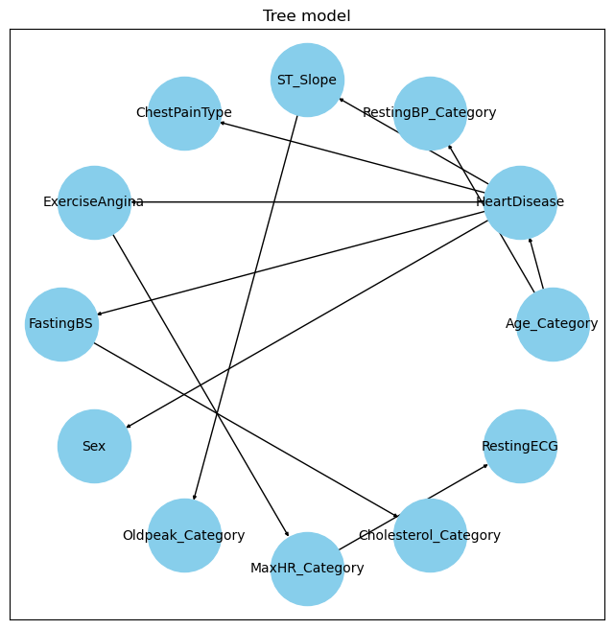
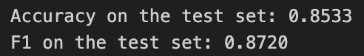
TREE MODEL
Learned automatically from the dataset using a tree search algorithm without imposing additional structural constraints and with all the features provided by the dataset.
Metrics

Slide 7
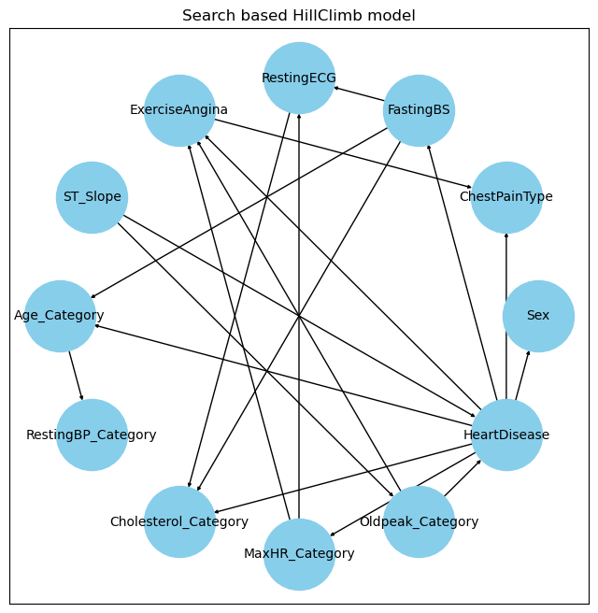
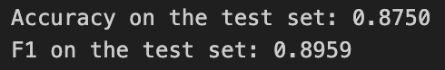
HILL – CLIMB
MODEL
Learned automatically from the dataset using hill-climb search algorithm, using all available features and without imposing structural constraints.
K2Score as scoring function
Metrics

Slide 8
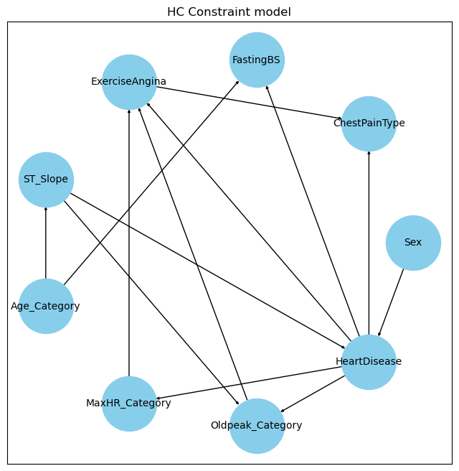
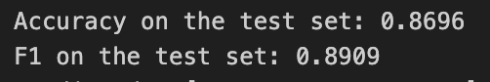
CUSTOM MODEL
The structure learning process was guided by enforcing specific constraints obtained from the study of the previous models and pruning the nodes that had the smallest correlation with Heart Disease.
K2Score as scoring function and Hill Climb search
Metrics

Slide 9
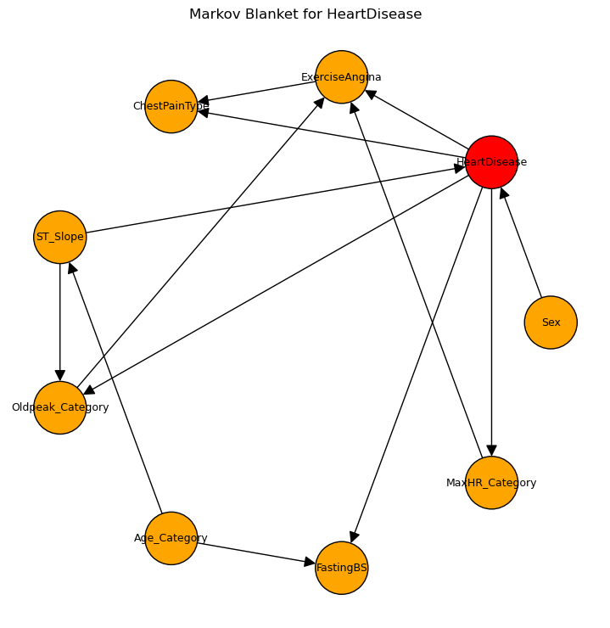
MARKOV
BLANKETS
98.3%
ACCURACY
96.7%
PRECISION
96.5%
Prediction Error
RECALL
96.6%
F1 SCORE

Slide 10

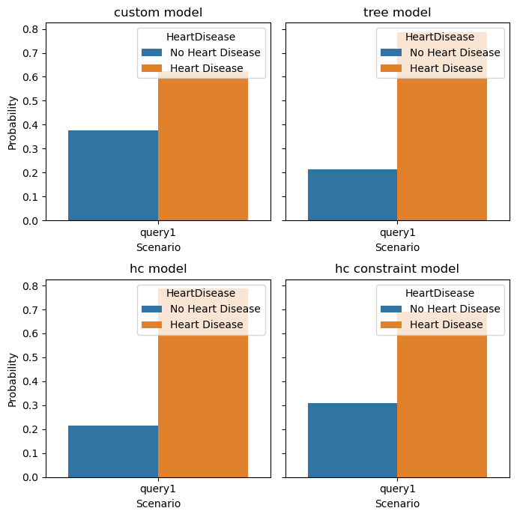
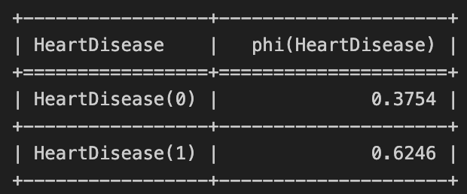
QUERIES
Query 1: Heart Disease prediction on Age and Sex
$$P\left(HeartDisease \right| Age=2, Sex=1)$$
Each model is retrained 3 times over different seeds
The best model is chosen given the average performance

Slide 11
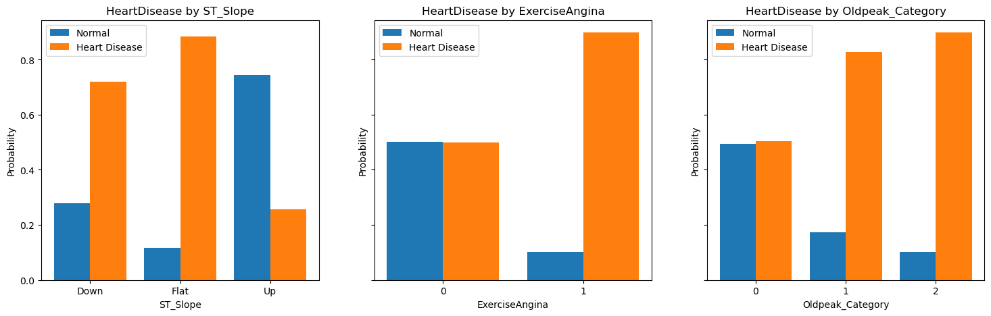
QUERIES
Query 2: Which stress factors cause a high risk of Heart disease in a male Adult patient
$$P\left(HeartDisease \right| Age=2, Sex=1, ST_{Slope}=1)$$
$$P\left(HeartDisease \right| Age=2, Sex=1,ExerciseAngina=1)$$
$$P\left(HeartDisease \right| Age=2, Sex=1, Oldpeak=1)$$

Slide 12
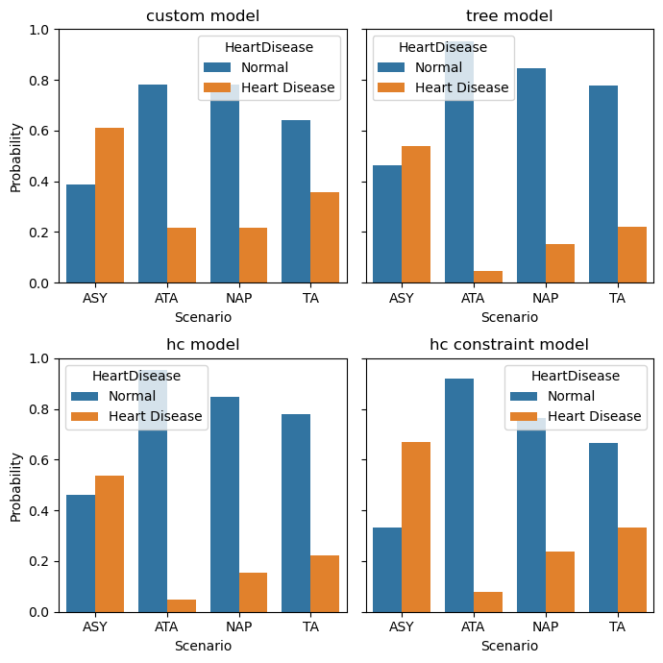

QUERIES
Query 3: Heart Disease risk by age and chest pain type comparison among models
$$P\left(HeartDisease \right| Age=0, ChestPainType=C)$$
$$with C ∈\{0, 1, 2, 3\}$$

Slide 13

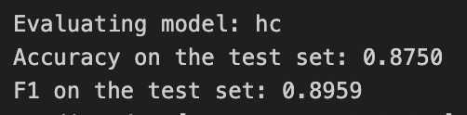
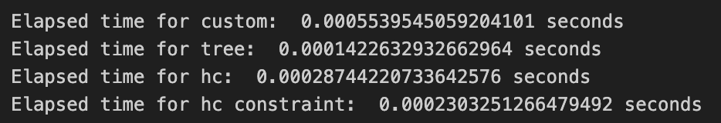
CONCLUSIONS
In this project we show an application of BN for the diagnosis and explanation of CVDs starting from clinical features.
Among the models the best performance is obtained by the Hill Climb model with constraints. This model is also the most efficient.
Seeing the results and the nature of the dataset, we still advise further testing on newer data to check if the designed models work as stated and guidance from experts of the medical domain in order to provide better constraints to the Hill Climb model since we see its potential improvement.

Slide 14
TITOLONE
descrizione
Nel caso ti servano alter slide da aggiungere

Slide 15
Thanks

